Slide 1
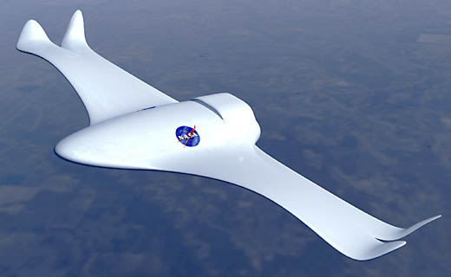
Aerospace Engineering
By: Caleb Cook

Slide 2
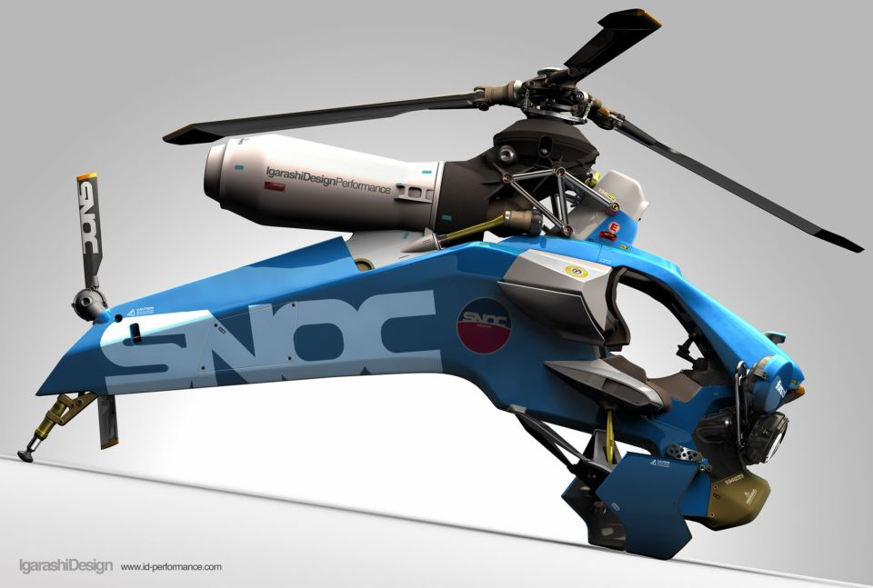
What is aerospace engineering?
Aerospace engineering is making and refining of aircraft and space craft.

Slide 3
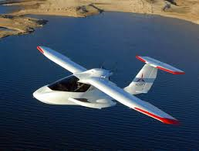
Work and Pay
Most engineers in this “sub-genre” earn a yearly pay of $103,000. The work put into their job requires extensive studying, designing, testing, revising, re-testing until the final product is absolutely perfect, down to every panel, screw head, and every seam. A typical week could require 50+ hrs to reach deadlines.

